Slide 1
HOTEL RESERVATION EDA
Presented by: Mohammed yasser mohammed

Slide 2
DATA Statitics

Slide 3
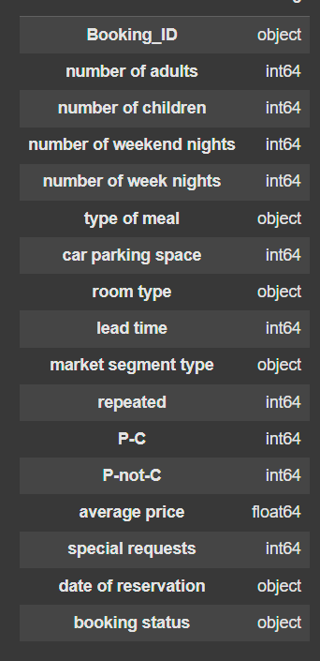
DATA STATISTICS
No. of records = 36285
No. of Features: 17
Number of Numerical Features = 9
Number of Categorical Features = 7
1 ID Feature

Slide 4
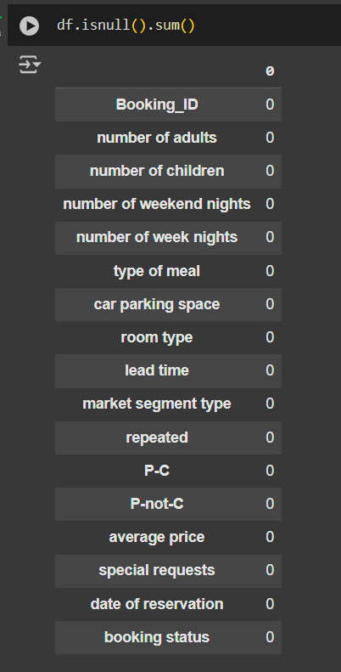
No NULL VALUES (Missing Data)

Slide 5
Univariate analysis

Slide 6
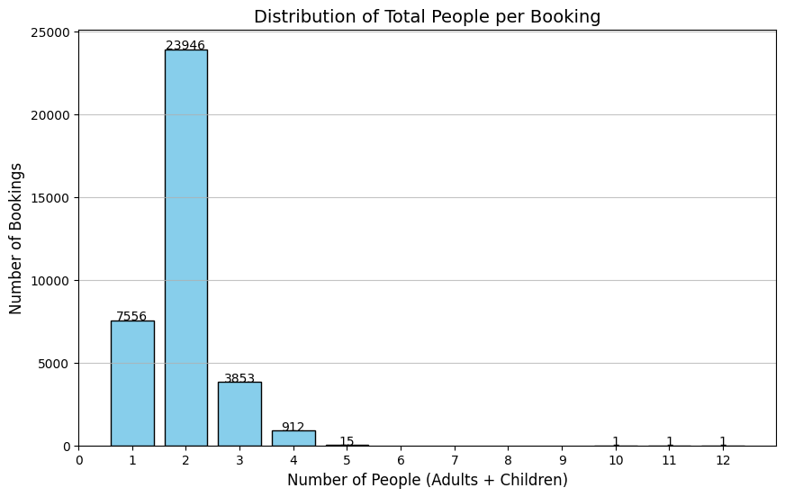
Distribution of Total People Per room
Most Bookings mostly contain 2 people
Assuming that bookings with 0 people are considered outliers.
Maximum number of people in a single room = 5 assuming that 10,11,12 people are considered outliers
Outliers !!!

Slide 7
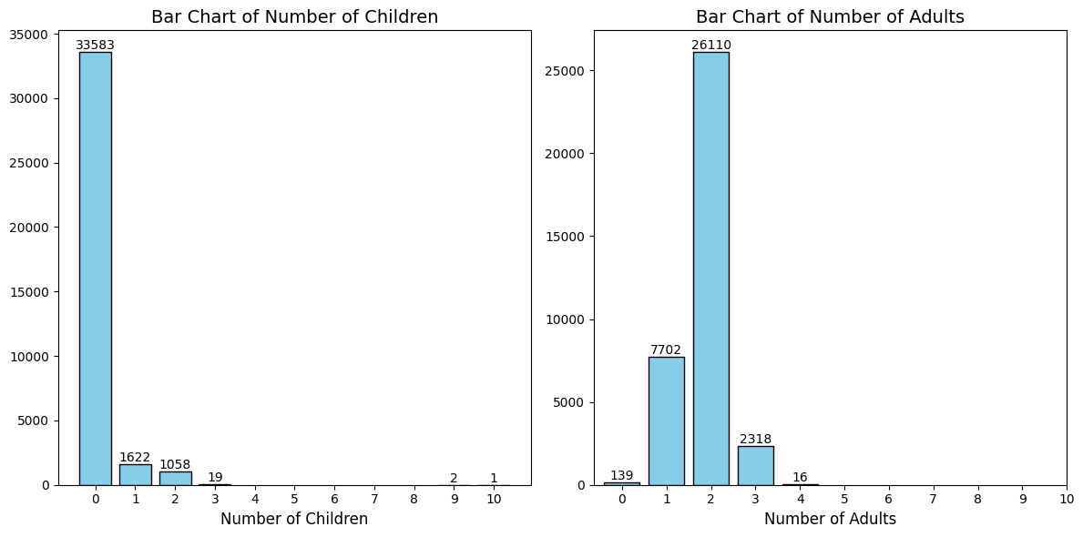
ADULTS VS CHILDREN
Most Bookings doesn’t have children.
Most Booking contains 2 adults
Assuming that no booking can have only children.
Outliers !!!

Slide 8
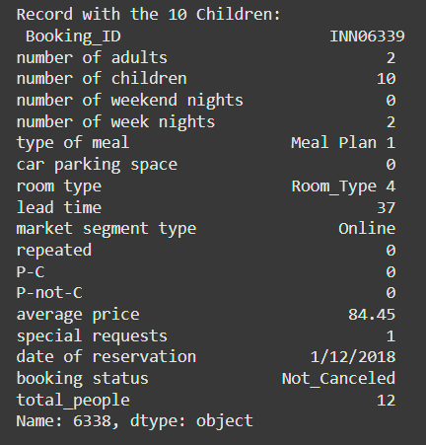
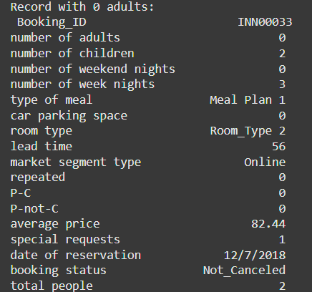
10 Children ?!! 0 Adults ?!!
Low Average price for 10 children so this is considered an outlier
A room cant have only children so this is considered an outlier

Slide 9
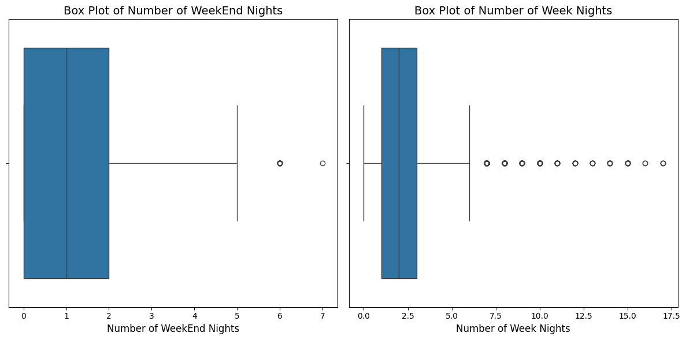
NUMBER of WEEKEND VS WEEK NIGHts
Most people spend on average 1 weekend night or 2 week nights

Slide 10
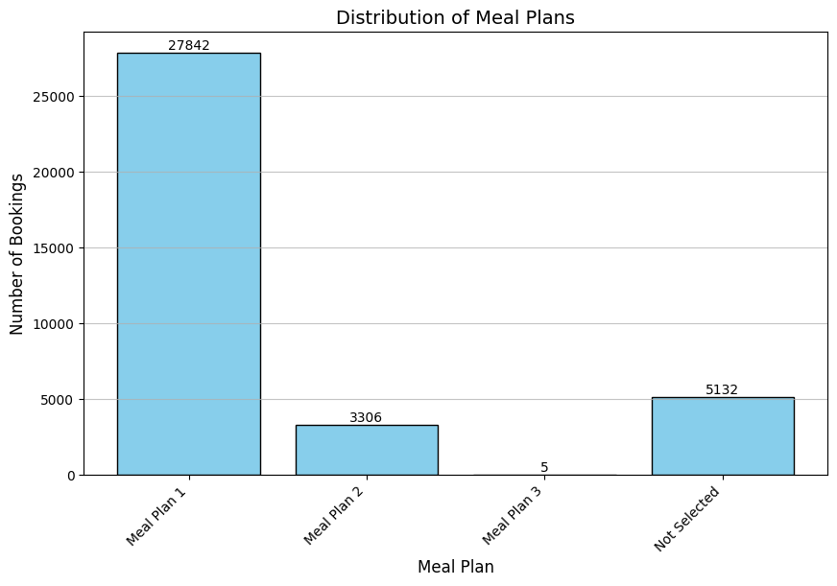
Most Popular MEAL PLAN
Most Popular Meal Plan is Meal Plan 1 while the least popular was Meal Plan 3

Slide 11
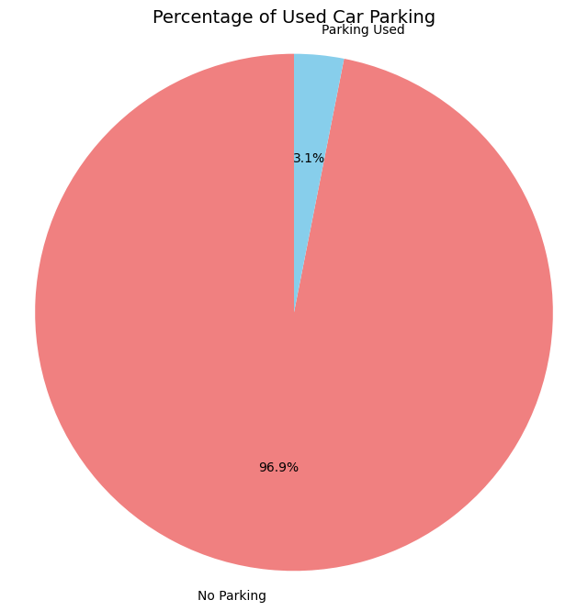
Used Car Parking
Only 3.1% of the bookings used the car parking.

Slide 12
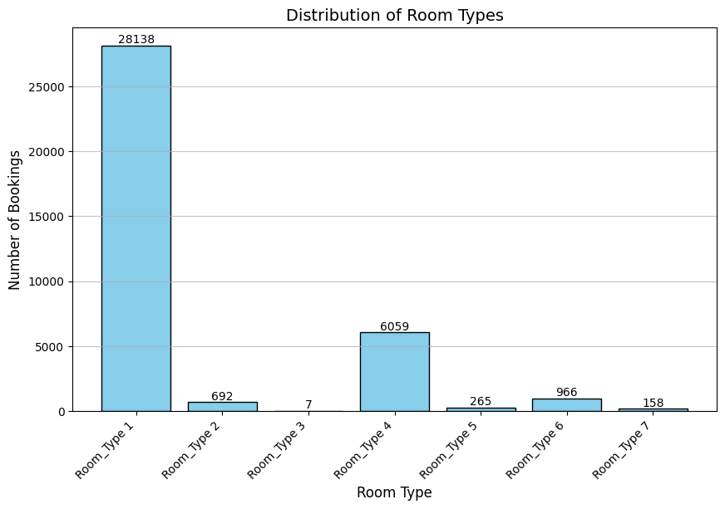
Most Popular room type
The most popular room type was Room_Type_1 while the least popular was Room_Type_3 with only 7 bookings.

Slide 13
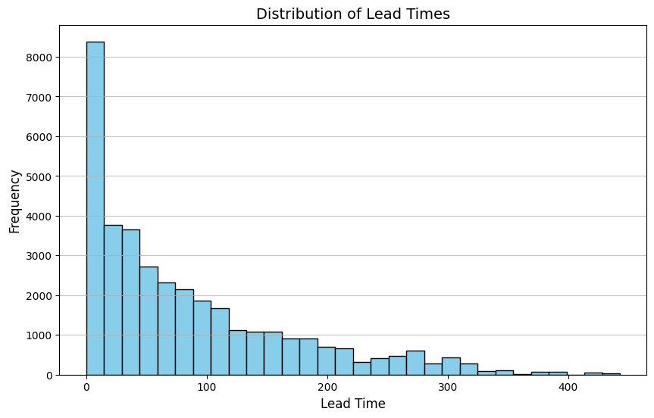
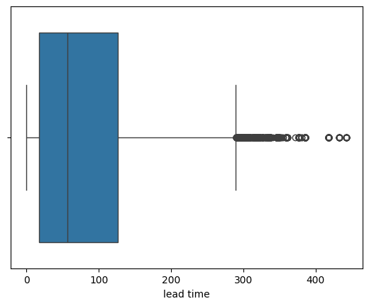
How many days do people book beforehand ?
The average lead time is 82 days
Most lead times where from 0-10 days and the number of bookings decreases as lead time increases
Indicating that people prefer to book close to the current time
Outliers !!!

Slide 14
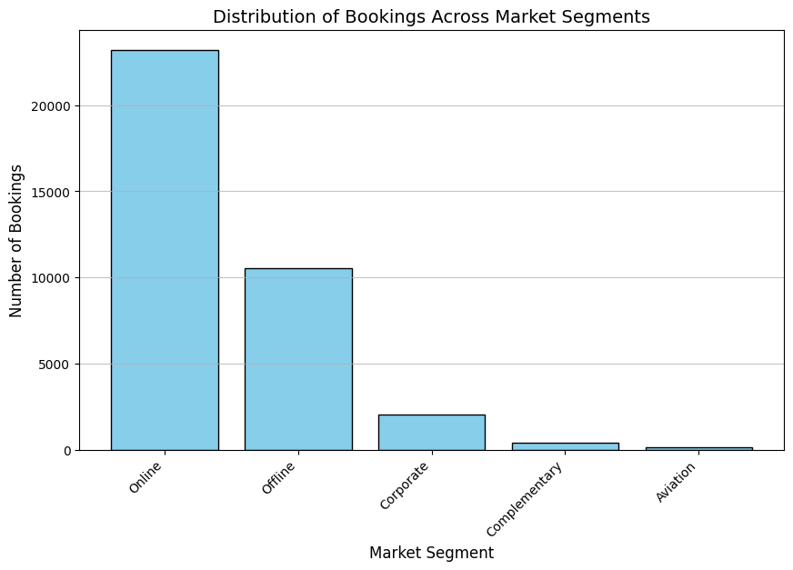
Where do People Come from ?
Most people prefer to book online than offline
Aviation is has the least share of the booking market segment.

Slide 15
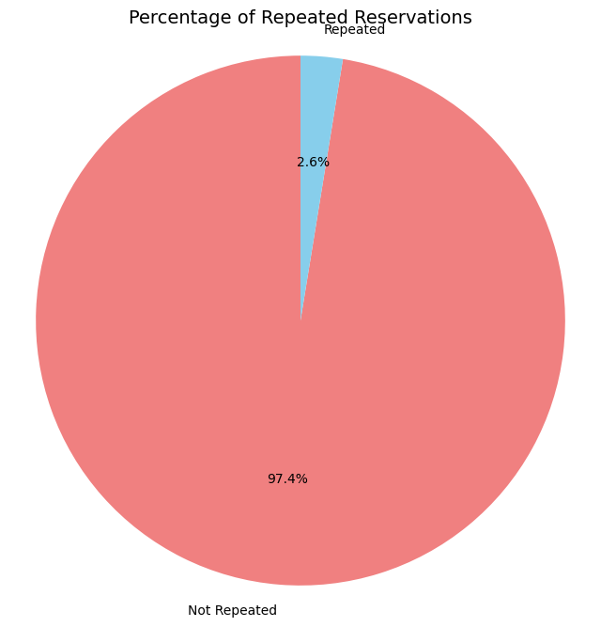
Do people come again ?
Only 2.6% are repeated customers
97.4% are new-comers

Slide 16
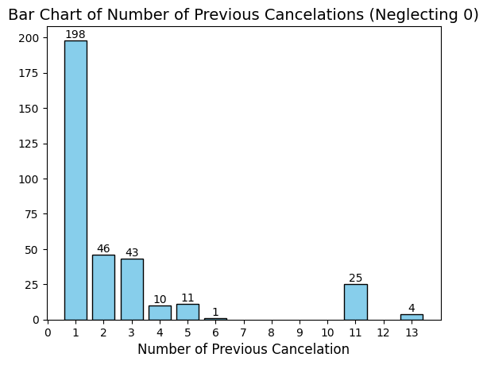
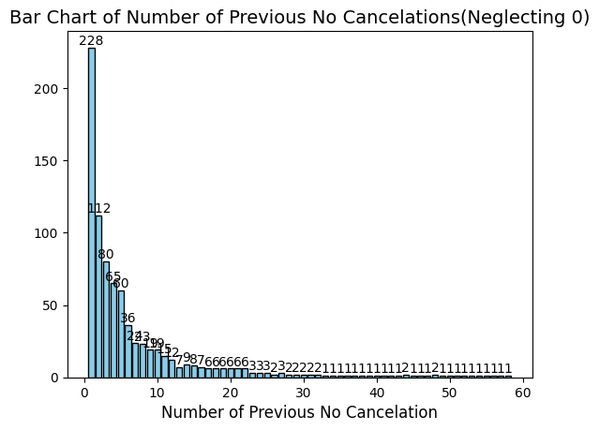
Do people come again after cancelation ?
Neglecting New comers (with P-C and P-not-C of 0) as they aren’t important for this feature.
The 2 features has similar disturbution.
The 2 features are skewed-left

Slide 17
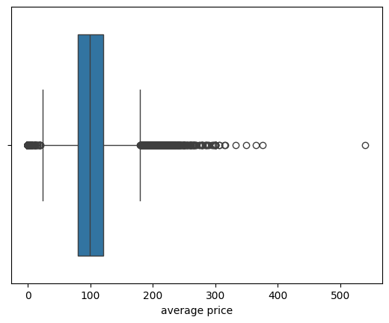
How much do we charge ?
The average price is $103.
Outliers !!!

Slide 18
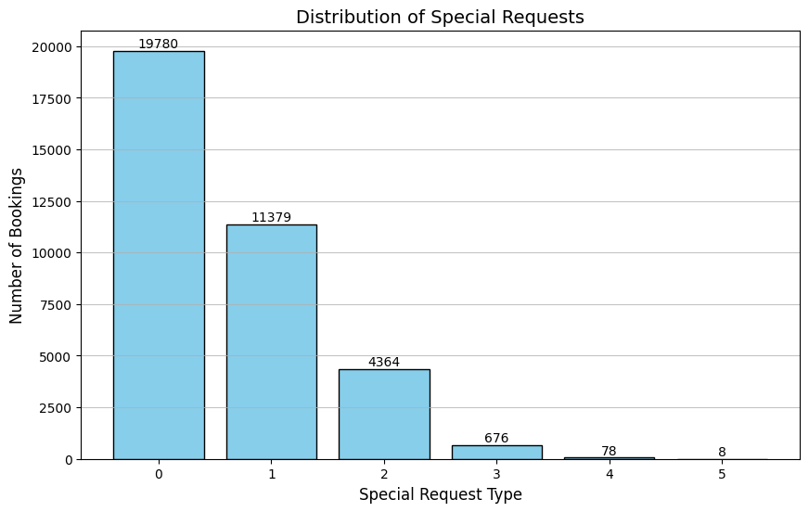
Any special requests ?
Most People has no special request.
Most people who require special request usually ask for 1

Slide 19
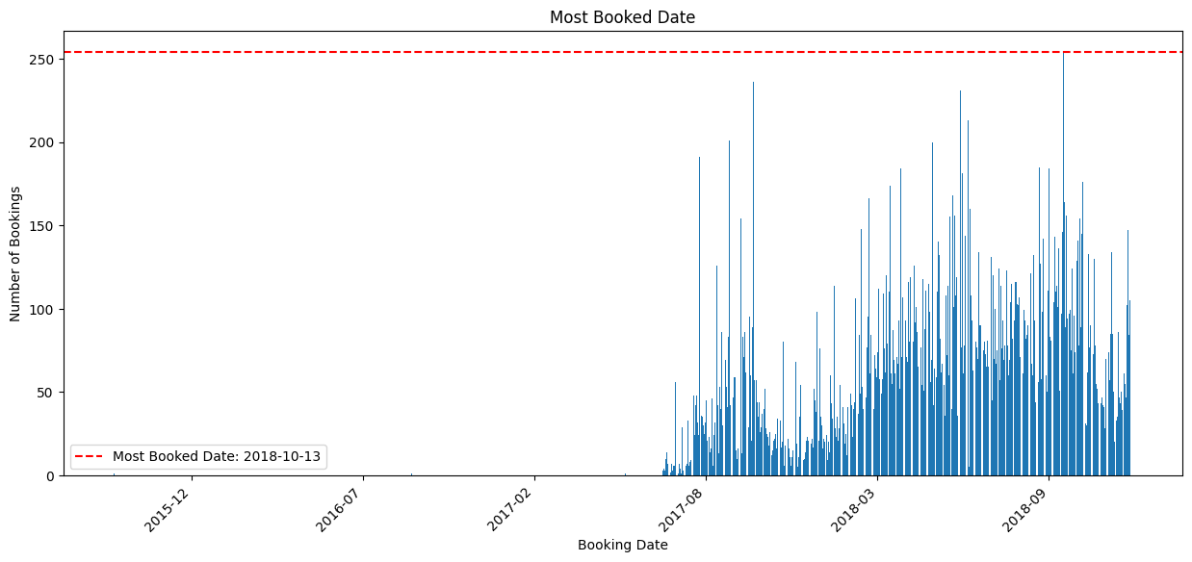
Busy days
13-OCT-2018 was the most booked date with 254 bookings in that single day.
We can also extract the months as a feature as each month has a trend

Slide 20
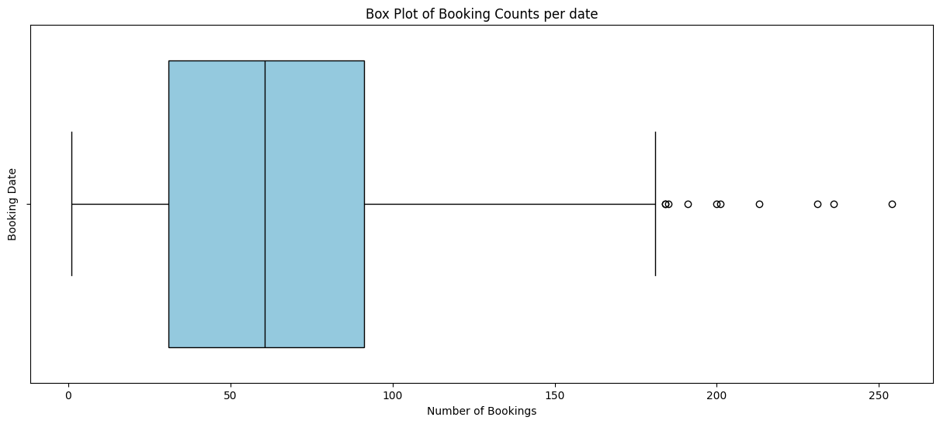
Any Outliers in number of bookings in a single day
We can’t specify days as outliers as they may collide with a special holiday causing all the bookings.

Slide 21
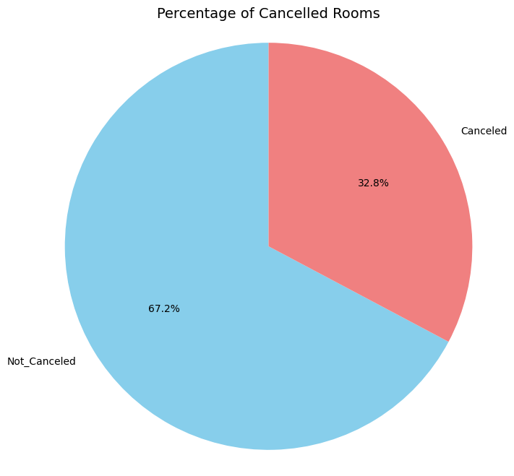
Changed Your mind ?
32.8% have cancelled there booking.
While the most have not cancelled their booking.

Slide 22
Some Data Cleaning
Performed some (not all) of data cleaning to help get a great understanding of the next section is bivariate analysis

Slide 23
Removing outliers
Removed the average price oulties leaving out 34589 records
Replacing the huge lead times with the 3rd quarter lead time
Removing records with no adults and (9 and 10) children leaving 34589 records

Slide 24
Bivariate Analysis
Analysis between 2 variables

Slide 25
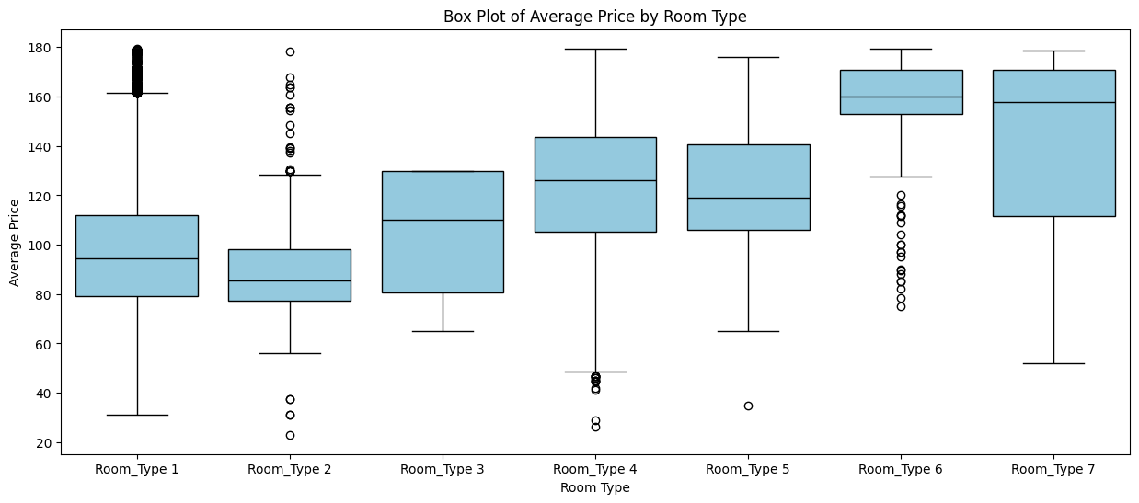
Average price per room
There is a slight increase in the average price with the type of room

Slide 26
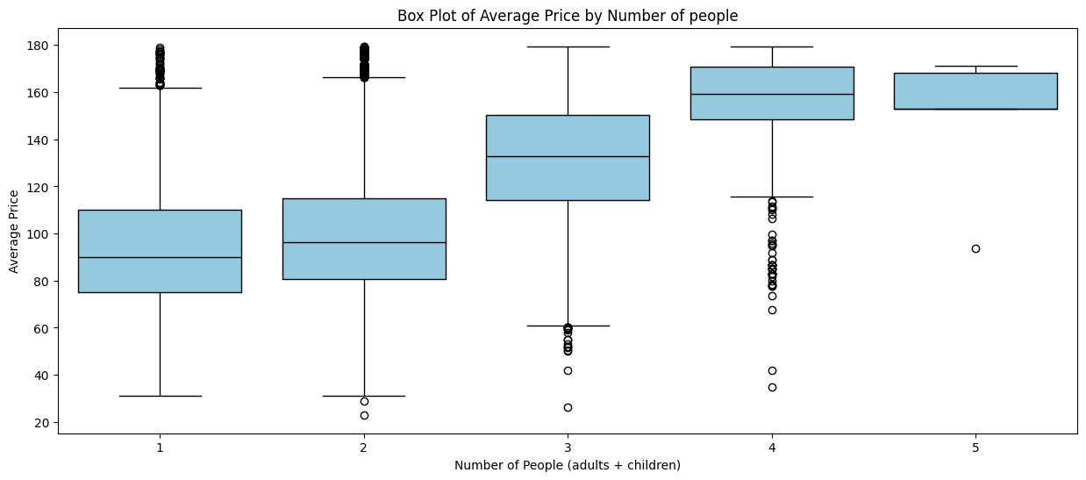
Average price per Person
There is a noticeable increase in with the average price and the number of people in the booking.

Slide 27
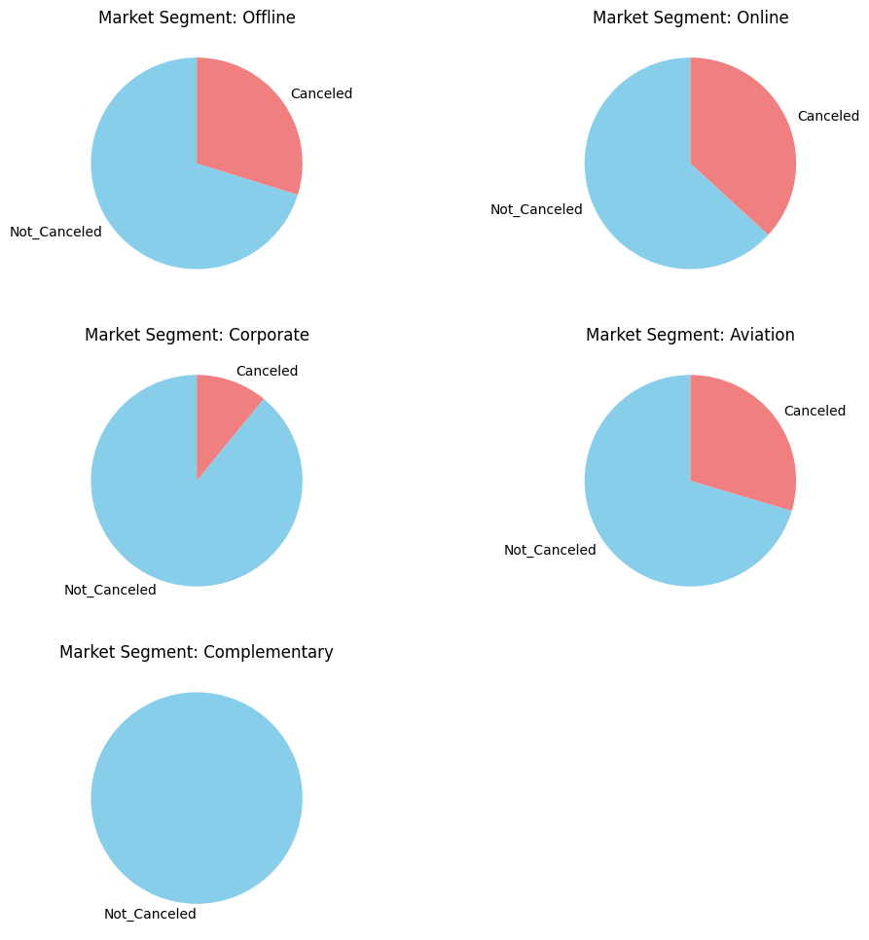
Which market segment cancels there booking
Online customers have the highest change of cancelling there booking
Complementary customers very rarely and may be never cancels there booking

Slide 28
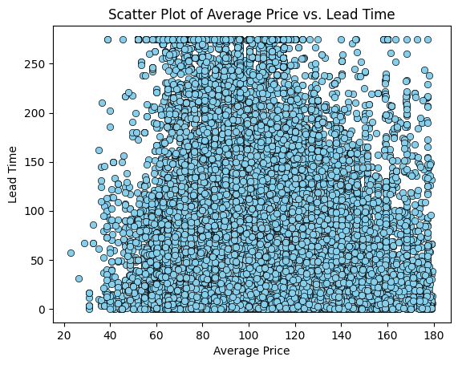
Does Lead Time Affect the Average Price
There is no correlation between the lead times and the average price.

Slide 29
The END

